Slide 1
Decision Tree

Slide 2
INTRODUCTION
Decision Tree is a Supervised learning technique that can be used for both classification and Regression problems, but mostly it is preferred for solving Classification problems.
It is a tree-structured classifier, where internal nodes represent the features of a dataset, branches represent the decision rules and each leaf node represents the outcome.

Slide 3
It is a graphical representation for getting all the possible solutions to a problem/decision based on given conditions.
A decision tree simply asks a question, and based on the answer (Yes/No), it further split the tree into subtrees.

Slide 4
In a Decision tree, there are two nodes, which are the Decision Node and Leaf Node.
Decision nodes are used to make any decision and have multiple branches, whereas Leaf nodes are the output of those decisions and do not contain any further branches.
The decisions or the test are performed on the basis of features of the given dataset.

Slide 5


Slide 6
Why use Decision Trees?
Decision Trees usually mimic human thinking ability while making a decision, so it is easy to understand.
The logic behind the decision tree can be easily understood because it shows a tree-like structure.

Slide 7
Decision Tree Terminologies
Root Node: Root node is from where the decision tree starts. It represents the entire dataset, which further gets divided into two or more homogeneous sets.
Leaf Node: Leaf nodes are the final output node, and the tree cannot be segregated further after getting a leaf node.
Splitting: Splitting is the process of dividing the decision node/root node into sub-nodes according to the given conditions.

Slide 8
Decision Tree Terminologies
Branch/Sub Tree: A tree formed by splitting the tree.
Pruning: Pruning is the process of removing the unwanted branches from the tree.
Parent/Child node: The root node of the tree is called the parent node, and other nodes are called the child nodes.

Slide 9
Advantages of the Decision Tree
It is simple to understand as it follows the same process which a human follow while making any decision in real-life.
It can be very useful for solving decision-related problems.
It helps to think about all the possible outcomes for a problem.
There is less requirement of data cleaning compared to other algorithms.

Slide 10
Disadvantages of the Decision Tree
The decision tree contains lots of layers, which makes it complex.
It may have an overfitting issue, which can be resolved using the Random Forest algorithm.
For more class labels, the computational complexity of the decision tree may increase.

Slide 11
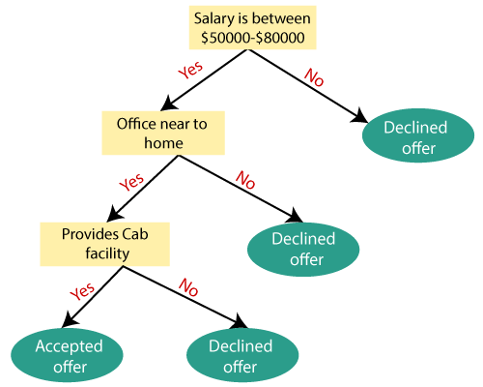

Slide 12
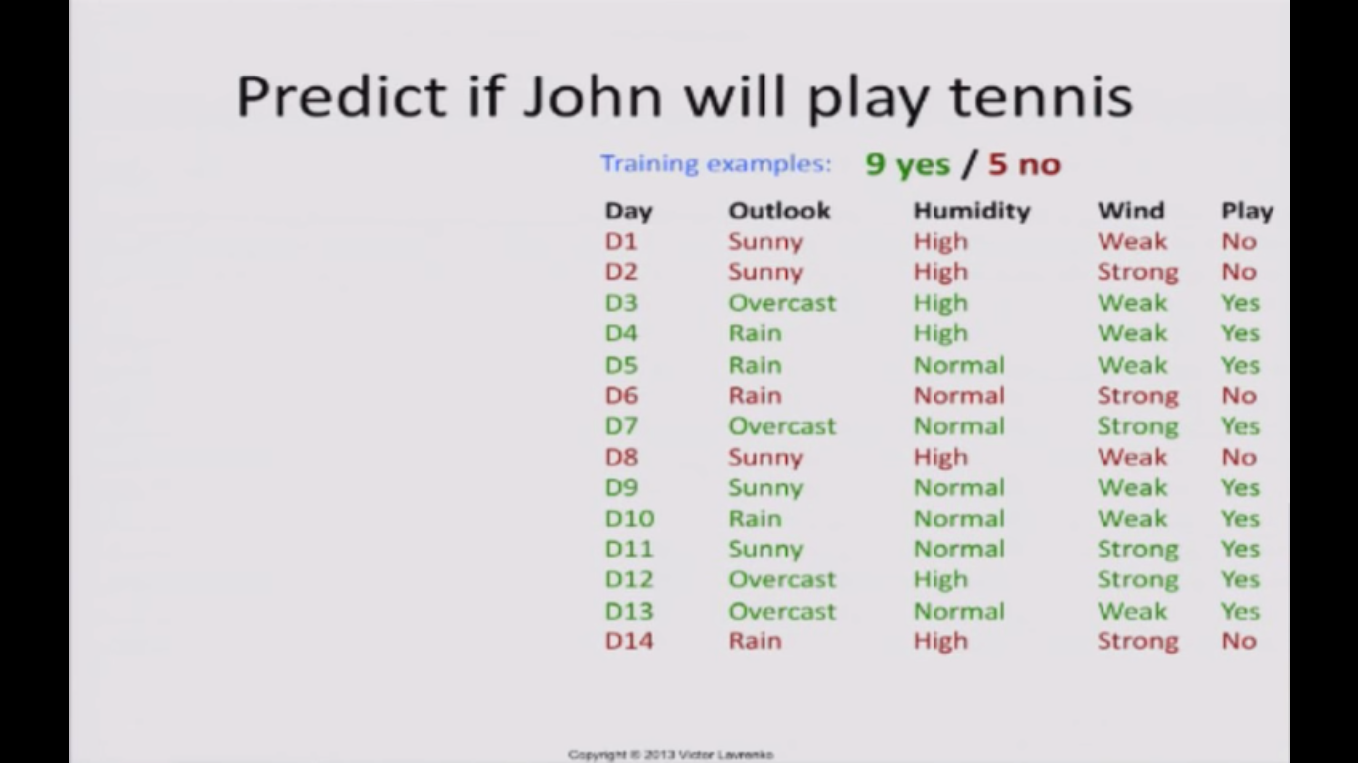
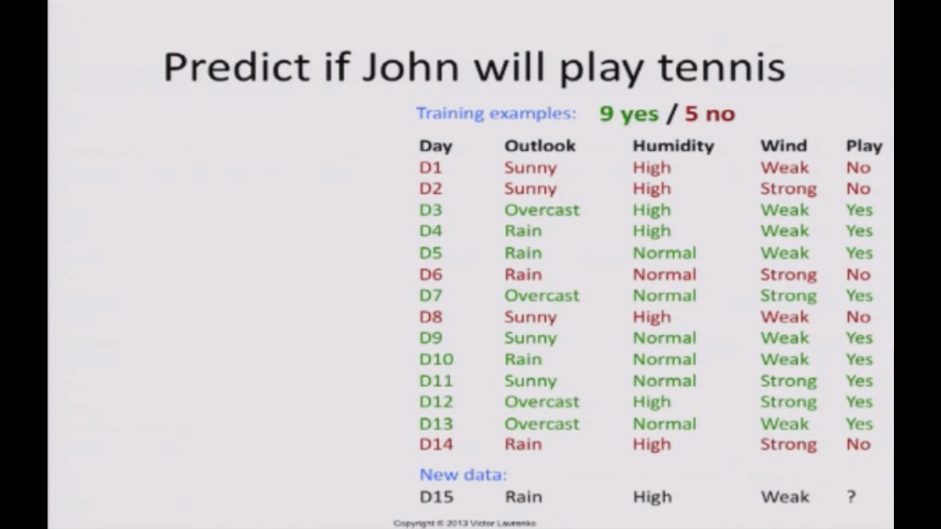

Slide 13
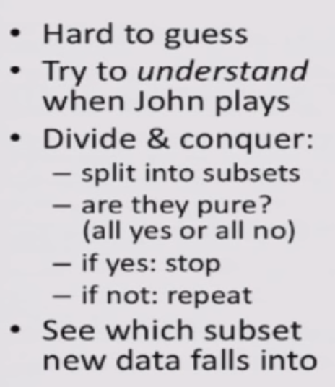

Slide 14
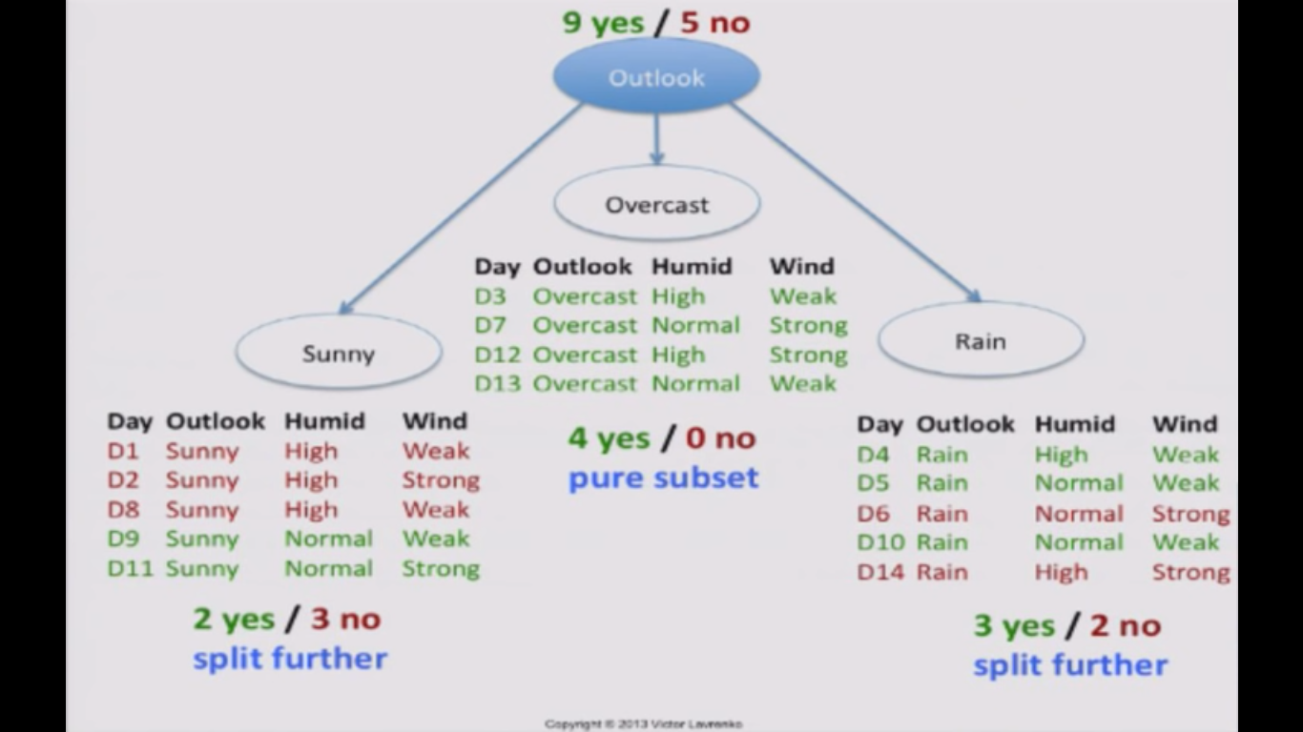

Slide 15
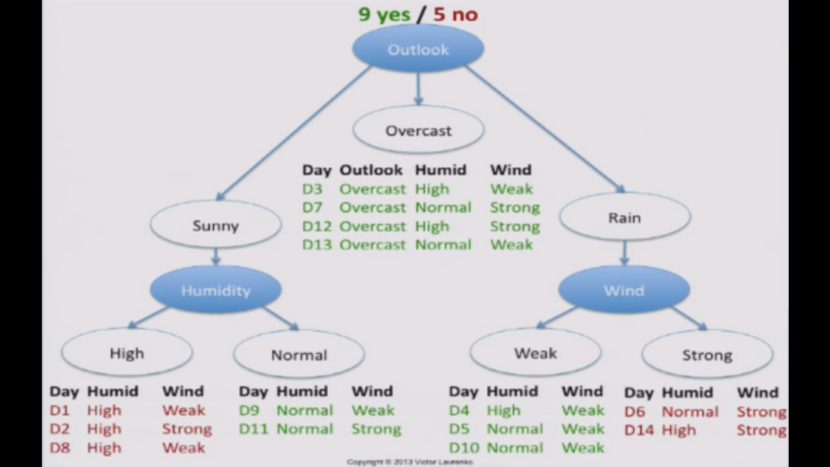

Slide 16
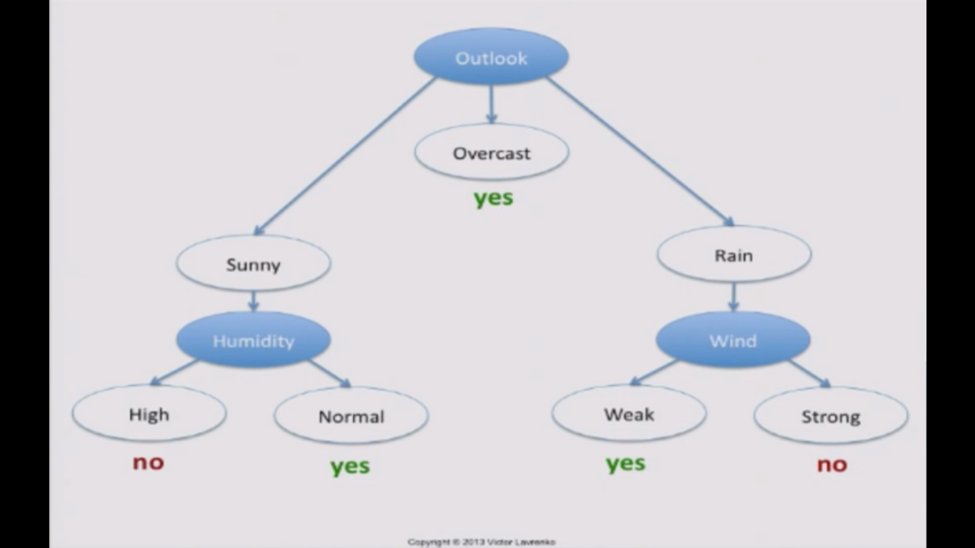

Slide 17
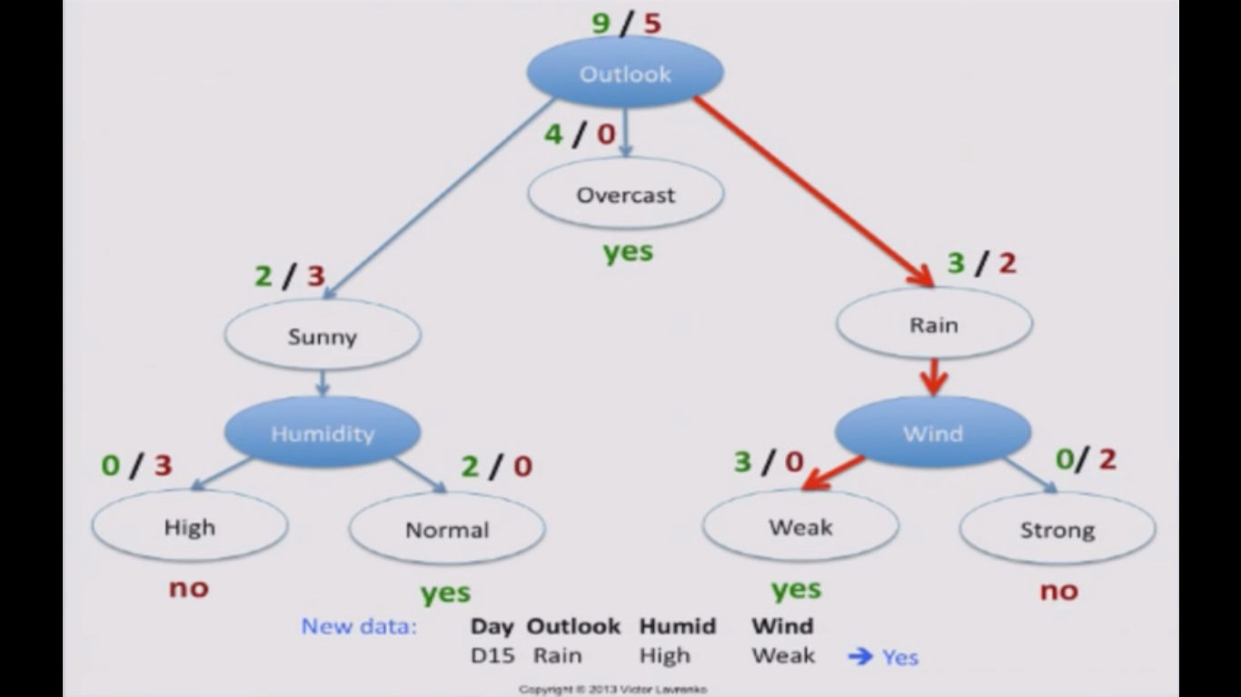

Slide 18
Hunt’s Algorithm
Step-1: Begin the tree with the root node, says S, which contains the complete dataset.
Step-2: Find the best attribute in the dataset using Attribute Selection Measure (ASM).
Step-3: Divide the S into subsets that contains possible values for the best attributes.
Step-4: Generate the decision tree node, which contains the best attribute.
Step-5: Recursively make new decision trees using the subsets of the dataset created in step -3. Continue this process until a stage is reached where you cannot further classify the nodes and called the final node as a leaf node.

Slide 19
Attribute Selection Measures
While implementing a Decision tree, the main issue arises that how to select the best attribute for the root node and for sub-nodes. So, to solve such problems there is a technique which is called as Attribute selection measure or ASM.
By this measurement, we can easily select the best attribute for the nodes of the tree. There are two popular techniques for ASM, which are:
Information Gain
Gini Index

Slide 20
Information Gain
Information gain is the measurement of changes in entropy after the segmentation of a dataset based on an attribute.
It calculates how much information a feature provides us about a class.
According to the value of information gain, we split the node and build the decision tree.
A decision tree algorithm always tries to maximize the value of information gain, and a node/attribute having the highest information gain is split first. It can be calculated using the below formula:

Slide 21
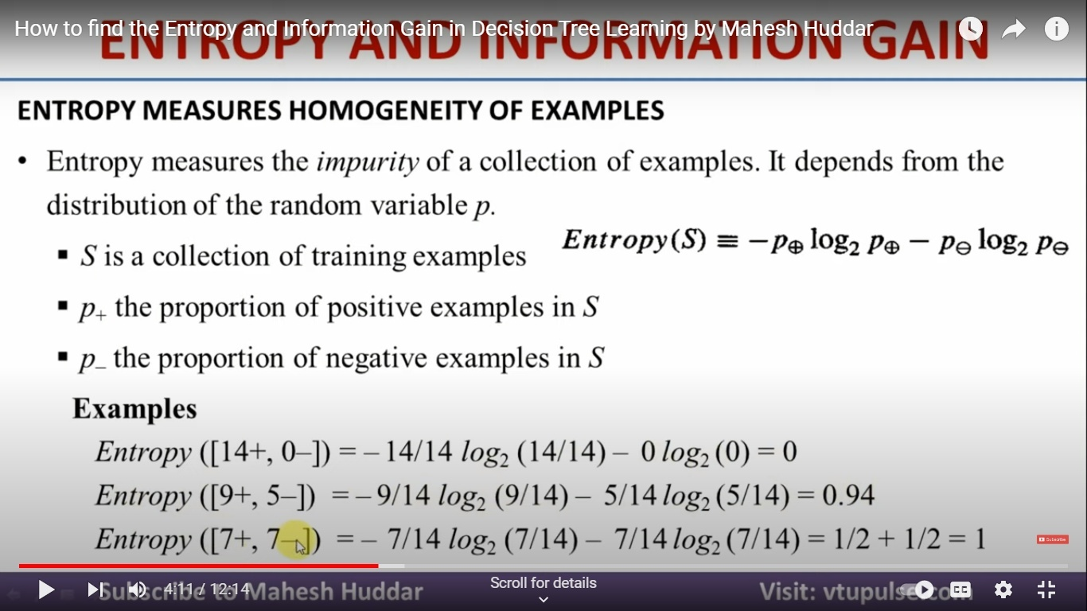

Slide 22
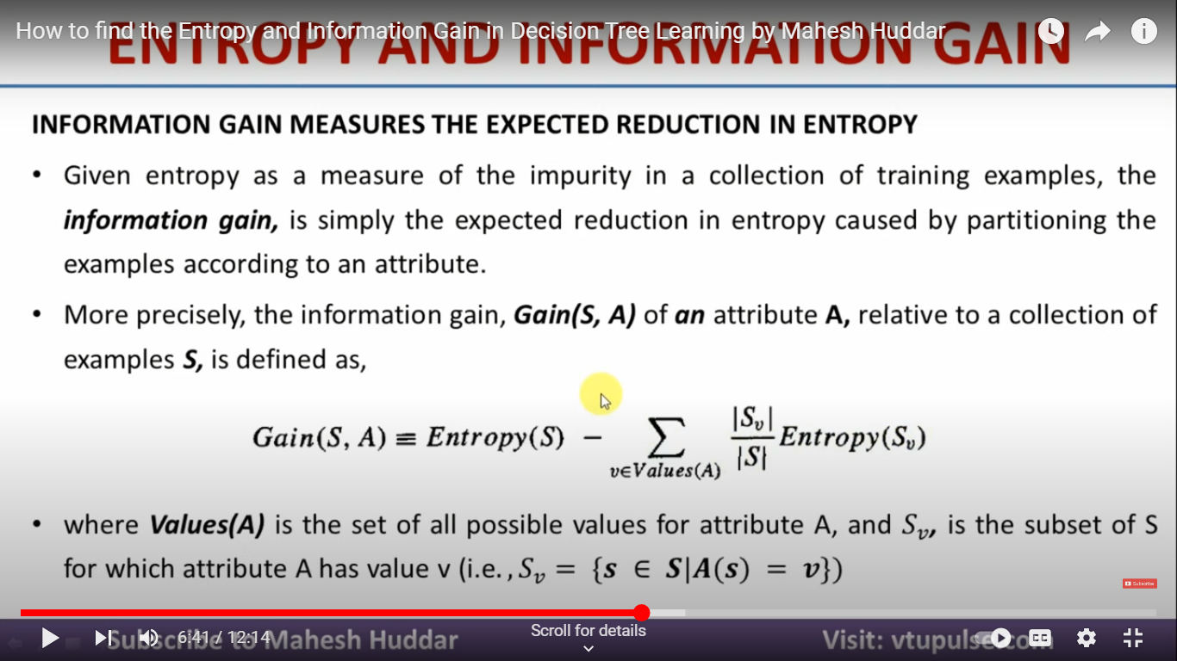

Slide 23
S.No. | Outlook | Humidity | Wind | Play
1 | Sunny | High | Weak | No
2 | Sunny | High | Strong | No
3 | Overcast | High | Weak | Yes
4 | Rain | High | Weak | Yes
5 | Rain | Normal | Weak | Yes
6 | Rain | Normal | Strong | No
7 | Overcast | Normal | Strong | Yes
8 | Sunny | High | Weak | No
9 | Sunny | Normal | Weak | Yes
10 | Rain | Normal | Weak | Yes
11 | Sunny | Normal | Strong | Yes
12 | Overcast | High | Strong | Yes
13 | Overcast | Normal | Weak | Yes
14 | Rain | High | Strong | No

Slide 24
Calculation of Information Gain
We will now calculate the Information Gain with the following -
Calculating the Information Gain for Outlook
Calculating the Information Gain for Humidity
Calculating the Information Gain for Wind

Slide 25
Calculating the Information Gain for Outlook
Value(Outlook) = Sunny, Overcast, Rain
S = 14 [9+, 5-] p (+ve) = 9/14 p (-ve) = 5/14
S(Sunny) = 5 [2+, 3-] p (+ve) = 2/5 p (-ve) = 3/5
S(Overcast)=4 [4+, 0-] p (+ve) = 4/4 p (-ve) = 0/4
S(Rain) =5 [3+, 2-] p (+ve) =3/5 p (-ve) = 2/5
Entropy(s) = -9/14*log₂(9/14)-5/14*log₂(5/14) = 0.94
Entropy(S(Sunny)) = -2/5*log₂(2/5) – 3/5*log₂(3/5) = 0.97
Entropy(S(Overcast)) = -4/5*log₂(4/4) – 0/4*log₂(0/4) = 0
Entropy(S(Rain)) = -3/5*log₂(3/5) – 2/5*log₂(2/5) =0.97
Information Gain (Outlook)
= Entropy(s) – 5/14* Entropy(S(Sunny)) – 4/14* Entropy(S(Overcast)) – 5/14*Entropy(S(Rain))
= 0.94 – 0.36*0.97 – 0.29*0 - 0.36*0.97
=0.24

Slide 26
Value(Humidity) = High, Normal
S = 14 [9+, 5-] p (+ve) = 9/14 p (-ve) = 5/14
S(High) = 7 [3+,4-] p (+ve) = 3/7 p (-ve) = 4/7
S(Normal) = 7 [6+, 1-] p (+ve) =6/7 p (-ve) = 1/7
Entropy(s) = -9/14*log₂(9/14)-5/14*log₂(5/14) = 0.94
Entropy(S(High)) = -3/7*log₂(3/7) –4/7*log₂(4/7) = 0.99
Entropy(S(Normal)) = -6/7*log₂(6/7) – 1/7*log₂(1/7) = 0.59
Information Gain (Humidity)
= Entropy(s) – 7/14* Entropy(S(High)) –7/14*
Entropy(S(Normal))
= 0.94 – 0.5*0.99 – 0.5*0.59
=0.15

Slide 27
Value(Wind) = Weak, Strong
S = 14 [9+, 5-] p (+ve) = 9/14 p (-ve) = 5/14
S(Weak) = 8 [6+,2-] p (+ve) = 6/8 p (-ve) = 2/8
S(Strong) = 6 [3+, 3-] p (+ve) = 3/6 p (-ve) = 3/6
Entropy(s) = -9/14*log₂(9/14)-5/14*log₂(5/14) = 0.94
Entropy(S(Weak)) = -6/8*log₂(3/8) –2/8*log₂(2/8) = 0.81
Entropy(S(Strong)) = -3/6*log₂(6/6) – 3/6*log₂(1/6) = 1
Information Gain (Wind)
= Entropy(s) – 8/14* Entropy(S(Weak)) –6/14*
Entropy(S(Strong))
= 0.94 – 0.571*0.81 – 0.428*1
=0.048

Slide 28
Information Gain attributes or features
Attributes/Features | Information Gain
Outlook | 0.24
Humidity | 0.15
Wind | 0.048
From the above table, we observe that ‘Outlook’ has the highest Information Gain and hence, it will be chosen as the root node for how the decision tree works.

Slide 29
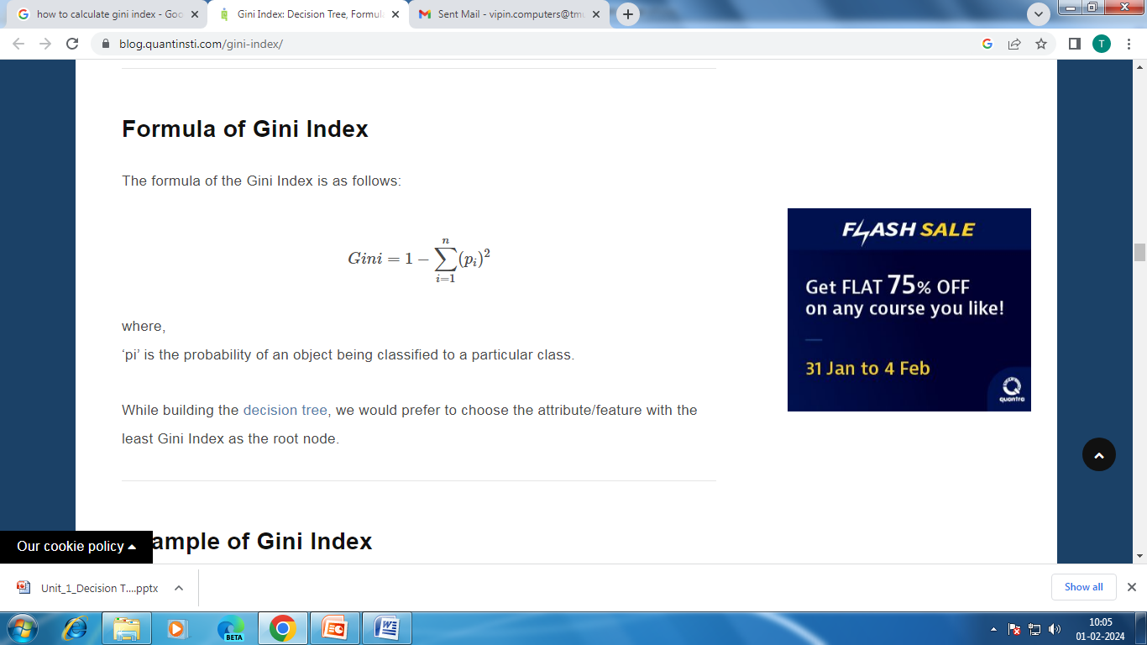
Gini index
Gini index is a measure of impurity or purity used while creating a decision tree
An attribute with the low Gini index should be preferred as compared to the high Gini index.
Gini index can be calculated using the below formula:
where, ‘p_{i}’ is the probability of an object being classified to a particular class

Slide 30
S.No. | Outlook | Humidity | Wind | Play
1 | Sunny | High | Weak | No
2 | Sunny | High | Strong | No
3 | Overcast | High | Weak | Yes
4 | Rain | High | Weak | Yes
5 | Rain | Normal | Weak | Yes
6 | Rain | Normal | Strong | No
7 | Overcast | Normal | Strong | Yes
8 | Sunny | High | Weak | No
9 | Sunny | Normal | Weak | Yes
10 | Rain | Normal | Weak | Yes
11 | Sunny | Normal | Strong | Yes
12 | Overcast | High | Strong | Yes
13 | Overcast | Normal | Weak | Yes
14 | Rain | High | Strong | No

Slide 31
We will now calculate the Gini Index with the following -
Calculating the Gini Index for Outlook
Calculating the Gini Index for Humidity
Calculating the Gini Index for Wind

Slide 32
Calculating the Gini Index for Outlook
Value(Outlook) = Sunny, Overcast, Rain
S = 14 [9+, 5-] p (+ve) = 9/14 p (-ve) = 5/14
S(Sunny)= 5 [2+, 3-] p (+ve) = 2/5 p (-ve) = 3/5
S(Overcast) =4 [4+, 0-] p (+ve) = 4/4 p (-ve) = 0/4
S(Rain) =5 [3+, 2-] p (+ve) = 3/5 p (-ve) = 2/5

Slide 33
Gini Index(Sunny)
= 1 - ((2/5)^2 + (3/5)^2)
= 1 - (0.16 + 0.36)
= 1-.0.52
= 0.48
Gini Index(Overcast)
= 1 - ((4/4)^2 + (0/4)^2)
= 1 - (1+0)
= 0
Gini Index(Rain)
= 1 - ((3/5)^2 + (2/5)^2)
= 1 - (.36 + .16)
= 1-.0.52
= 0.48
Weighted sum of the Gini Indices can be calculated as follows:
Gini Index for Outlook = (5/14)*0.48 + (4/14)*0 + (5/14)*0.48
= 0.3428

Slide 34
Value(Humidity) = High, Normal
S = 14 [9+, 5-] p (+ve) = 9/14 p (-ve) = 5/14
S(High) = 7 [3+,4-] p (+ve) = 3/7 p (-ve) = 4/7
S(Normal) = 7 [6+, 1-] p (+ve) = 6/7 p (-ve) = 1/7

Slide 35
Gini Index(High)
= 1 - ((3/7)^2 + (4/7)^2)
= 1 - (0.183673 + 0.326531)
= 1-.0.510204
= 0.489796
Gini Index(Normal)
= 1 - ((6/7)^2 + (1/7)^2)
= 1 - (0.020408+0.755102)
= 0.244898
Weighted sum of the Gini Indices can be calculated as follows:
Gini Index for Humidity = (7/14)0.489796+ (7/14) 0.244898
= 0.367347

Slide 36
Value(Wind) = Weak, Strong
S = 14 [9+, 5-] p (+ve) = 9/14 p (-ve) = 5/14
S(Weak)= 8 [6+,2-] p (+ve) = 6/8 p (-ve) = 2/8
S(Strong) = 6 [3+, 3-] p (+ve) = 3/6 p (-ve) = 3/6

Slide 37
Gini Index(Weak)
= 1 - ((6/8)^2 + (2/8)^2)
= 1 - (0.5625+0.0625)
= 1-. (0.625)
= 0.375
Gini Index(Strong)
= 1 - ((3/6)^2 + (3/6)^2)
= 1 - (0.25+0.25)
= 0.5
Weighted sum of the Gini Indices can be calculated as follows:
Gini Index for Wind = (8/14)0.375+ (6/14)0.5
= 0.428571

Slide 38
Gini Index attributes or features
Attributes/Features | Gini Index
Outlook | 0.3428
Humidity | 0.367347
Wind | 0.428571
From the above table, we observe that ‘Outlook’ has the lowest Gini Index and hence, it will be chosen as the root node for how the decision tree works.

Slide 39
Determining the sub nodes or the branches (features going down) of the decision tree
We will repeat the same procedure to determine the sub-nodes or branches of the decision tree.
We will calculate the Gini Index for the ‘Sunny’ branch of Outlook as follows:
S.No. | Outlook | Humidity | Wind | Play
1 | Sunny | High | Weak | No
2 | Sunny | High | Strong | No
8 | Sunny | High | Weak | No
9 | Sunny | Normal | Weak | Yes
11 | Sunny | Normal | Strong | Yes

Slide 40
Calculating Gini Index of Humidity for Sunny Outlook
Humidity for Sunny Outlook is high 3 times out of 5 and normal 2 times out of 5 and the Gini Index of Humidity for Sunny Outlook is calculated as follows:
Value(Humidity) = High, Low
S = 5 [2+,3-] p (+ve) = 2/5 p (-ve) = 3/5
S(High)= 3 [0+,3-] p (+ve) = 0/3 p (-ve) = 3/3
S(Normal)= 2 [2+,0-] p (+ve) = 2/2 p (-ve) = 0/2

Slide 41
Gini Index(High)
= 1 - ((0/3)^2 + (3/3)^2)
= 1 - (0+1)
= 1-. (1)
= 0
Gini Index(Normal)
= 1 - ((2/2)^2 + (0/2)^2)
= 1 - (1+0)
= 0
Weighted sum of the Gini Indices can be calculated as follows:
Gini Index for Humidity = (2/5)0+ (3/5)0
= 0

Slide 42
Calculating Gini Index of Wind for Sunny Outlook
Wind for Sunny Outlook is weak 3 times out of 5 and strong 2 times out of 5 and the Gini Index of Wind Sunny Outlook is calculated as follows:
Value(Wind) = Weak, Strong
S = 5 [2+,3-] p (+ve) = 2/5 p (-ve) = 3/5
S(Weak) = 3 [1+,2-] p (+ve) =1/3 p (-ve) = 2/3
S(Strong) = 2 [1+,1-] p (+ve) =1/2 p (-ve) = 1/2

Slide 43
Gini Index(Weak)
= 1 - ((1/3)^2 + (2/3)^2)
= 1 - (0.1111+0.4444)
= 1-. (0.5555)
= 0.4444
Gini Index(Strong)
= 1 - ((1/2)^2 + (1/2)^2)
= 1 - (1+0)
= 0.5
Weighted sum of the Gini Indices can be calculated as follows:
Gini Index for Wind = (2/5)0.4444+ (3/5)0.5
= 0.47776

Slide 44
Gini Index attributes or features
Attributes/Features | Gini Index
Humidity | 0
Wind | 0.47776
From the above table, we observe that ‘Humidity’ has the lowest Gini Index and hence, it will be chosen as the root node for how the decision tree works.

